Slide 1

Session 10
Namespaces

Slide 2
Objectives
Define and describe namespaces
Explain nested namespaces

Slide 3
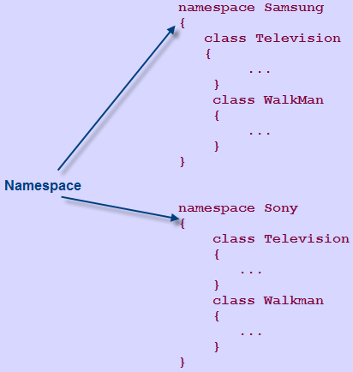
Namespaces
A namespace:
Is used in C# to group classes logically and prevent name clashes between classes with identical names.
Reduces any complexities when the same program is required in another application.

Slide 4
Introduction to Namespaces – Purpose 1-3
Consider Venice, which is a city in the US as well as in Italy.
You can easily distinguish between the two cities by associating them with their respective countries.
Similarly, when working on a huge project, there may be situations where classes have identical names.
This may result in name conflicts.
This problem can be solved by having the individual modules of the project use separate namespaces to store their respective classes.
By doing this, classes can have identical names without any resultant name clashes.
Example

Slide 5
Introduction to Namespaces – Purpose 2-3
The following code renames identical classes by inserting a descriptive prefix:
In the code:
The identical classes Television and WalkMan are prefixed with their respective company names to avoid any conflicts.
There cannot be two classes with the same name.
It is observed that the names of the classes get long and become difficult to maintain.
Snippet
class SamsungTelevision
{
...
}
class SamsungWalkMan
{
...
}
class SonyTelevision
{
...
}
class SonyWalkMan
{
...
}

Slide 6
Introduction to Namespaces – Purpose 3-3
The following code demonstrates a solution to overcome this, by using namespaces:
In the code:
Each of the identical classes is placed in their respective namespaces, which denote respective company names.
It can be observed that this is a neater, better organized, and more structured way to handle naming conflicts.
Snippet
namespace Samsung
{
class Television
{
...
}
class WalkMan
{
...
}
}
namespace Sony
{
class Television
{
...
}
class Walkman
{
...
}
}

Slide 7
Using Namespaces
C# allows you to specify a unique identifier for each namespace.
This identifier helps you to access the classes within the namespace.
Apart from classes, the following data structures can be declared in a namespace:
Interface
An interface is a reference type that contains declarations of the events, indexers, methods, and properties.
Structure
A structure is a value type that can hold values of different data types.
Enumeration
An enumeration is a value type that consists of a list of named constants.
Delegate
A delegate is a user-defined reference type that refers to one or more methods.
It can be used to pass data as parameters to methods.
This list of named constants is known as the enumerator list.
It can include fields, methods, constants, constructors, properties, indexers, operators, and other structures.
Interfaces are inherited by classes and structures and all the declarations are implemented in these classes and structures.

Slide 8
Characteristics and Benefits
A namespace groups common and related classes, structures, or interfaces, which support OOP concepts of encapsulation and abstraction.
A namespace:
Provides a hierarchical structure that helps to identify the logic for grouping the classes.
Allows you to add more classes, structures, enumerations, delegates, and interfaces once the namespace is declared.
Includes classes with names that are unique within the namespace.
A namespace provides the following benefits:
A namespace allows you to use multiple classes with same names by creating them in different namespaces.
It makes the system modular.

Slide 9
Built-in Namespaces 1-3
The .NET Framework comprises several built-in namespaces that contain:
Classes
Interfaces
Structures
Delegates
Enumerations
These namespaces are referred to as system-defined namespaces.
The most commonly used built-in namespace of the .NET Framework is System.
The System namespace contains classes that:
Define value and reference data types, interfaces, and other namespaces.
Allow you to interact with the system, including the standard input and output devices.

Slide 10
Built-in Namespaces 2-3
Some of the most widely used namespaces within the System namespace are as follows:
System.Collections
The System.Collections namespace contains classes and interfaces that define complex data structures such as lists, queues, bit arrays, hash tables, and dictionaries.
System.Data
The System.Data namespace contains classes that make up the ADO.NET architecture.
System.Diagnostics
The System.Diagnostics namespace contains classes that are used to interact with the system processes.
System.IO
The System.IO namespace contains classes that enable you to read from and write to data streams and files.
System.Net
The System.Net namespace contains classes that allow you to create Web-based applications.
System.Web
The System.Web namespace provides classes and interfaces that allow communication between the browser and the server.
The ADO.NET architecture allows you to build components that can be used to insert, modify, and delete data from multiple data sources.
This namespace also provides classes that are used to debug applications and trace the execution of the code.

Slide 11
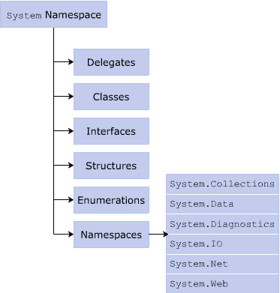
Built-in Namespaces 3-3
The following figure displays some built-in namespaces:

Slide 12
Using the System Namespace 1-6
The System namespace is imported by default in the .NET Framework.
It appears as the first line of the program along with the using keyword.
For referring to classes within a built-in namespace, you need to explicitly refer to the required classes.
It is done by specifying the namespace and the class name separated by the dot (.) operator after the using keyword at the beginning of the program.
You can refer to classes within the namespaces in the same manner without the using keyword.
However, this results in redundancy because you need to mention the whole declaration every time you refer to the class in the code.

Slide 13
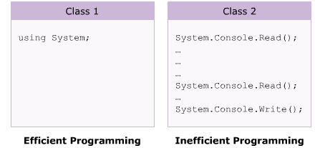
Using the System Namespace 2-6
The two approaches of referencing the System namespace are:
Though both are technically valid, the first approach is more recommended.

Slide 14
Using the System Namespace 3-6
The following syntax is used to access a method in a system-defined namespace:
In the syntax:
NamespaceName: Is the name of the namespace.
ClassName: Is the name of the class that you want to access.
MethodName: Is the name of the method within the class that is to be invoked.
Syntax
<NamespaceName>.<ClassName>.<MethodName>;

Slide 15
Using the System Namespace 4-6
The following syntax is used to access the system-defined namespaces with the using keyword:
In the syntax:
NamespaceName: Is the name of the namespace and it will refer to all classes, interfaces, structures, and enumerations.
ClassName: Is the name of the specific class defined in the namespace that you want to access.
Syntax
using <NamespaceName>;
using <NamespaceName>.<ClassName>;

Slide 16
Using the System Namespace 5-6
The following code demonstrates the use of the using keyword with namespaces:
In the code:
The System namespace is imported within the program with the using keyword.
If this were not done, the program would not even compile as the Console class exists in the System namespace.
Hello World
Snippet
using System;
class World
{
static void Main(string[] args)
{
Console.WriteLine(“Hello World”);
}
}
Output

Slide 17
Using the System Namespace 6-6
The following code refers to the Console class of the System namespace multiple times:
In the code, the class is not imported, but the System namespace members are used along with the statements.
Hello World
This is C# Programming
You have executed a simple program of C#
Snippet
class World
{
static void Main(string[] args)
{
System.Console.WriteLine(“Hello World”);
System.Console.WriteLine(“This is C# Programming”);
System.Console.WriteLine(“You have executed a simple program of
C#”);
}
}
Output

Slide 18
Custom Namespaces 1-9
C# allows you to create namespaces with appropriate names to organize structures, classes, interfaces, delegates, and enumerations that can be used across different C# applications.
When using a custom namespace, you need not worry about name clashes with classes, interfaces, and so on in other namespaces.
Custom namespaces:
Enable you to control the scope of a class by deciding the appropriate namespace for the class.
Declared using the namespace keyword and is accessed with the using keyword similar to any built-in namespace.

Slide 19
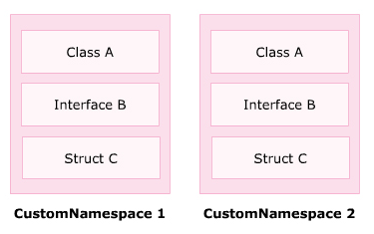
Custom Namespaces 2-9
The following figure displays a general example of using custom namespaces:

Slide 20
Custom Namespaces 3-9
The following syntax is used to declare a custom namespace:
In the syntax:
NamespaceName: Is the name of the custom namespace.
type-declarations: Are the different types that can be declared. It can be a class, interface, struct, enum, delegate, or another namespace.
Syntax
namespace <NamespaceName>
{
//type-declarations;
}

Slide 21
Custom Namespaces 4-9
The following code creates a custom namespace named Department:
In the code:
Department is declared as the custom namespace.
The class Sales is declared within this namespace.
You have created a custom namespace named Department
Snippet
namespace Department
{
class Sales
{
static void Main(string [] args)
{
System.Console.WriteLine(“You have created a custom namespace
named Department”);
}
}
}
Output

Slide 22
Custom Namespaces 5-9
Once a namespace is created, C# allows:
Additional classes to be included later in that namespace. Hence, namespaces are additive.
A namespace to be declared more than once.
These namespaces can be split and saved in separate files or in the same file.
At the time of compilation, these namespaces are added together.

Slide 23
Custom Namespaces 6-9
The namespace split over multiple files is illustrated in the next three code snippets:
Snippet
// The Automotive namespace contains the class SpareParts and // this namespace is partly stored in the SpareParts.cs file.
using System;
namespace Automotive
{
public class SpareParts
{
string _spareName;
public SpareParts()
{
_spareName = "Gear Box";
}
public void Display()
{
Console.WriteLine("Spare Part name: " + _spareName);
}
}
}

Slide 24
Custom Namespaces 7-9
Snippet
//The Automotive namespace contains the class Category and
// this namespace is partly stored in the Category.cs file.
using System;
namespace Automotive
{
public class Category
{
string _category;
public Category()
{
_category = "Multi Utility Vehicle";
}
public void Display()
{
Console.WriteLine("Category: " + _category);
}
}
}

Slide 25
Custom Namespaces 8-9
Snippet
//The Automotive namespace contains the class Toyota and this // namespace is partly stored in the Toyota.cs file.
namespace Automotive
{
class Toyota
{
static void Main(string[] args)
{
Category objCategory = new Category();
SpareParts objSpare = new SpareParts();
objCategory.Display();
objSpare.Display();
}
}
}

Slide 26
Custom Namespaces 9-9
In the three code snippets:
The three classes, SpareParts, Category, and Toyota are stored in three different files, SpareParts.cs, Category.cs, and Toyota.cs respectively.
Even though the classes are stored in different files, they are still in the same namespace, namely Automotive. Hence, a reference is not required here.
A single namespace Automotive is used to enclose three different classes.
The code for each class is saved as a separate file.
When the three files are compiled, the resultant namespace is still Automotive.
The following figure shows the output of the application containing the three files:
Output

Slide 27
Guidelines for Creating Custom Namespaces 1-2
While designing a large framework for a project, it is required to create namespaces to group the types into the appropriate namespaces such that the identical types do not collide.
Therefore, the following guidelines must be considered for creating custom namespaces:
All similar elements such as classes and interfaces must be created into a single namespace. This will form a logical grouping of similar types and any programmer will be easily able to search for similar classes.
Creating deep hierarchies that are difficult to browse must be avoided.
Creating too many namespaces must be avoided for simplicity.

Slide 28
Guidelines for Creating Custom Namespaces 2-2
Nested namespaces must contain types that depend on the namespace within which it is declared.
The classes in the Country.States.Cities namespace will depend on the classes in the namespace Country.States.
If a user has created a class called US in the States namespace, only the cities residing in U.S. can appear as classes in the Cities namespace.
Example
Example

Slide 29
Access Modifiers for Namespaces 1-2
Namespaces are always implicitly public.
You cannot apply access modifiers such as public, protected, private, or internal to namespaces.
The namespace is accessible by any other namespace or class that exists outside the accessed namespace.
The access scope of a namespace cannot be restricted.

Slide 30
Access Modifiers for Namespaces 2-2
If any of the access modifiers is specified in the namespace declaration, the compiler generates an error.
The following code attempts to declares the namespace as public:
The code generates the error, ‘A namespace declaration cannot have modifiers or attributes’.
Snippet
using System;
public namespace Products
{
class Computers
{
static void Main(string [] args)
{
Console.WriteLine(“This class provides information
about Computers”);
}
}
}

Slide 31
Unqualified Naming 1-2
A class defined within a namespace is accessed only by its name.
To access this class, you just have to specify the name of that class.
This form of specifying a class is known as Unqualified naming.
The use of unqualified naming results in short names and can be implemented by the using keyword.
This makes the program simple and readable.

Slide 32
Unqualified Naming 2-2
The following code displays the student’s name, ID, subject, and marks scored using an unqualified name:
In the code, the class ScoreReport uses the class StudentDetails defined in the namespace Examination. The class is accessed by its name.
using System;
using Students;
namespace Students
{
class StudentDetails
{
string _studName = “Alexander”;
int _studID = 30;
public StudentDetails()
{
Console.WriteLine(“Student Name: “ +
_studName);
Console.WriteLine(“Student ID: “ + _studID);
}
}
}
namespace Examination
{
class ScoreReport
{
public string Subject = “Science”;
public int Marks = 60;
static void Main(string[] args)
{
StudentDetails objStudents = new
StudentDetails();
ScoreReport objReport = new ScoreReport();
Console.WriteLine(“Subject: “ +
objReport.Subject);
Console.WriteLine(“Marks: “ + objReport.Marks);
}
}
}
Snippet

Slide 33
Qualified Naming 1-2
C# allows you to use a class outside its namespace.
A class outside its namespace can be accessed by specifying its namespace followed by the dot operator and the class name.
This form of specifying the class is known as Fully Qualified naming.
The use of fully qualified names results in long names and repetition throughout the code.
Instead, you can access classes outside their namespaces with the using keyword.
This makes the names short and meaningful.

Slide 34
Qualified Naming 2-2
The following code displays the student’s name, ID, subject and marks scored using a fully qualified name:
In the code, the class ScoreReport uses the class StudentDetails defined in the namespace Examination. The class is accessed by its fully qualified name.
Snippet
using System;
namespace Students
{
class StudentDetails
{
string _studName = “Alexander”;
int _studId = 30;
public StudentDetails()
{
Console.WriteLine(“Student Name: “ + _studName);
Console.WriteLine(“Student ID: “ + _studId);
}
}
}
namespace Examination
{
class ScoreReport
{
public string Subject = “Science”;
public int Marks = 60;
static void Main(string[] args)
{
Students.StudentDetails objStudents = new Students.
StudentDetails();
ScoreReport objReport = new ScoreReport();
Console.WriteLine(“Subject: “ + objReport.Subject);
Console.WriteLine(“Marks: “ + objReport.Marks);
}
}
}

Slide 35
Naming Conventions for Namespaces
When namespaces are being created to handle projects of an organization, it is recommended that namespaces are prefixed with the company name followed by the technology name, the feature, and the design of the brand.
Namespaces for projects of an organization can be created as follows:
CompanyName.TechnologyName[.Feature][.Design]
Naming conventions that should be followed for creating namespaces are:
Use Pascal case for naming the namespaces.
Use periods to separate the logical components.
Use plural names for namespaces wherever applicable.
Ensure that a namespace and a class do not have same names.
Ensure that the name of a namespace is not identical to the name of the assembly.

Slide 36
Nested Namespaces 1-2
C# allows you to define namespaces within a namespace.
This arrangement of namespaces is referred to as nested namespaces.
For an organization running multiple projects, nested namespaces is useful.
The root namespace can be given the name of the organization and nested namespaces can be given the names of individual projects or modules.
This allows the developers to store commonly used classes in appropriate namespaces and use them for all other similar programs.

Slide 37
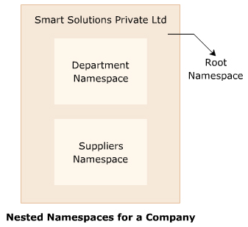
Nested Namespaces 2-2
The following figure illustrates the concept of nested namespaces:

Slide 38
Implementing Nested Namespaces 1-3
C# allows you to create a hierarchy of namespaces by creating namespaces within namespaces.
Such nesting of namespaces is done by enclosing one namespace declaration inside the declaration of the other namespace.
The following syntax can be used to create nested namespaces:
Syntax
namespace <NamespaceName>
{
namespace <NamespaceName>
{
}
namespace <NamespaceName>
{
}
}

Slide 39
Implementing Nested Namespaces 2-3
The following code creates nested namespaces:
In the code:
Contact is declared as a custom namespace that contains the class Employees and another namespace Salary.
The Salary namespace contains the class SalaryDetails.
Snippet
namespace Contact
{
public class Employees
{
public int EmpID;
}
namespace Salary
{
public class SalaryDetails
{
public double EmpSalary;
}
}
}

Slide 40
Implementing Nested Namespaces 3-3
The following code displays the salary of an employee using the nested namespace that was created in the previous code:
Salary: 1000.5
In the EmployeeDetails class of the code:
The object of the SalaryDetails class is created using the namespaces in which the classes are declared.
The value of the variable EmpSalary of the SalaryDetails class is initialized to 1000.5 and the salary amount is displayed as the output.
Snippet
using System;
class EmployeeDetails
{
static void Main(string [] args)
{
Contact.Salary.SalaryDetails objSal = new
Contact.Salary.SalaryDetails();
objSal.EmpSalary = 1000.50;
Console.WriteLine(“Salary: “ + objSal.EmpSalary);
}
}
Output

Slide 41
Namespace Aliases 1-5
Aliases:
Are temporary alternate names that refer to the same entity.
Are also useful when a program contains many nested namespace declarations and you would like to distinguish as to which class belongs to which namespace.
Would make the code more readable for other programmers and would make it easier to maintain.
The namespace referred to with the using keyword refers to all the classes within the namespace.
However, sometimes you might want to access only one class from a particular namespace.
You can use an alias name to refer to the required class and to prevent the use of fully qualified names.

Slide 42
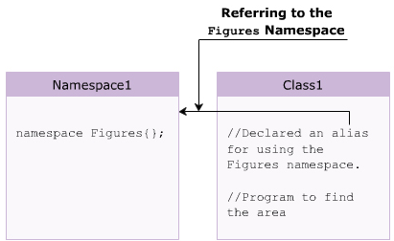
Namespace Aliases 2-5
The following figure displays an example of using namespace aliases:

Slide 43
Namespace Aliases 3-5
The following syntax is used for creating a namespace alias:
In the code:
aliasName: Is the user-defined name assigned to the namespace.
Syntax
using<aliasName> = <NamespaceName>;

Slide 44
Namespace Aliases 4-5
The following creates a custom namespace called Bank.Accounts.EmployeeDetails:
The following code displays the name of an employee using the aliases of the System.Console and Bank.Accounts.EmployeeDetails namespaces:
Snippet
namespace Bank.Accounts.EmployeeDetails
{
public class Employees
{
public string EmpName;
}
}
Snippet
using IO = System.Console;
using Emp = Bank.Accounts.EmployeeDetails;
class AliasExample
{
static void Main (string[] args)
{
Emp.Employees objEmp = new Emp.Employees();
objEmp.EmpName = “Peter”;
IO.WriteLine(“Employee Name: “ + objEmp.EmpName);
}
}

Slide 45
Namespace Aliases 5-5
Employee Name: Peter
In the code:
The Bank.Accounts.EmployeeDetails is aliased as Emp and System.Console is aliased as IO.
These alias names are used in the AliasExample class to access the Employees and Console classes defined in the respective namespaces.
Output

Slide 46
External Aliasing 1-3
Consider a large organization working on multiple projects.
The programmers working on two different projects may use the same class name belonging to the same namespace and store them in different assemblies.
The assemblies created can also contain similar method names.
When these assemblies are used in a single program and a common method from these assembles is invoked, compilation error is generated.
The compilation error occurs since the same method resides in both the assemblies.
This is called an ambiguous reference and it can be resolved by implementing external aliasing.
Example

Slide 47
External Aliasing 2-3
External aliasing in C#:
Allows the users to define assembly qualified namespace aliases.
Can be implemented using the extern keyword.
This is illustrated in the following code:
Snippet
extern alias LibraryOne;
extern alias LibraryTwo;
using System;
class Companies
{
static void Main (string [] args)
{
LibraryOne::Employees.Display();
LibraryTwo::Employees.Display();
}
}

Slide 48
External Aliasing 3-3
In the code:
The Companies class references to two different assemblies in which the Employees class is created with the Display() method.
The external aliases for the two assemblies are defined as LibraryOne and LibraryTwo.
During the compilation of this code, the aliases must be mapped to the path of the respective assemblies through the compiler options.
For example, you may write:
/reference: LibraryOne =One.dll
/reference: LibraryTwo =two.dll

Slide 49
Namespace Alias Qualifier 1-10
There are some situations wherein the alias provided to a namespace matches with the name of an existing namespace.
Then, the compiler generates an error while executing the program that references to that namespace.
This is illustrated in the following code:
Snippet
//The following program is saved in the Automobile.cs file // under the Automotive project.
using System;
using System.Collections.Generic;
using System.Text;
using Utility_Vehicle.Car;
using Utility_Vehicle = Automotive.Vehicle.Jeep;
namespace Automotive

Slide 50
Namespace Alias Qualifier 2-10
{
namespace Vehicle
{
namespace Jeep
{
class Category
{
string _category;
public Category()
{
_category = "Multi Utility Vehicle";
}
public void Display()
{
Console.WriteLine("Jeep Category: " +
_category);
}
}
}
class Automobile
{
static void Main(string[] args)
{
Category objCat = new Category();
objCat.Display();
Utility_Vehicle.Category objCategory = new
Utility_Vehicle.Category();
objCategory.Display();
}
}
}
}

Slide 51
Namespace Alias Qualifier 3-10
Another project is created under the Automotive project to store the program shown in the following code:
Snippet
//The following program is saved in the Category.cs file under the
//Utility_Vehicle project created under the Automotive project.
using System;
using System.Collections.Generic;
using System.Text;
namespace Utility_Vehicle
{
namespace Car
{
class Category
{
string _category;
public Category()
{
_category = "Luxury Vehicle";
}
public void Display()
{
Console.WriteLine("Car Category: " +
_category);
}
}
}
}

Slide 52
Namespace Alias Qualifier 4-10
Both these files are compiled using the following syntax:
csc /out:<FileName>.exe <FullPath of File1>.cs <Full Path of File2>.cs
In the syntax:
FileName: Is the name of the single .exe file that will be generated.
FullPath of File 1: Is the complete path where the first file is located.
FullPath of File 2: Is the complete path where the second file is located.
Syntax

Slide 53
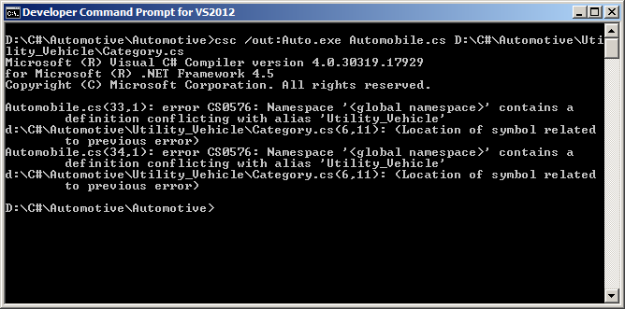
Namespace Alias Qualifier 5-10
The following figure shows the outcome of the compiled code:
In both the codes:
The namespaces Jeep and Car include the class Category.
An alias Utility_Vehicle is provided to the namespace Automotive.Jeep.
This alias matches with the name of the other namespace in which the namespace Car is nested.
To compile both the programs, the csc command is used which uses the complete path to refer to the Category.cs file.
In the Automobile.cs file, the alias name Utility_Vehicle is the same as the namespace which is being referred by the file. Due to this name conflict, the complier generates an error.
Output

Slide 54
Namespace Alias Qualifier 6-10
This problem of ambiguous name references can be resolved by using the namespace alias qualifier.
Namespace alias qualifier is a new feature of C# and it can be used in the form of:
<LeftOperand> :: <RightOperand>
In the syntax:
LeftOperand: Is a namespace alias, an extern, or a global identifier.
RightOperand: Is the type.
Syntax

Slide 55
Namespace Alias Qualifier 7-10
The correct code for this is given as follows:
Snippet
using System;
using System.Collections.Generic;
using System.Text;
using Utility_Vehicle.Car;
using Utility_Vehicle = Automotive.Vehicle.Jeep;
namespace Automotive
{
namespace Vehicle
{
namespace Jeep
{
class Category
{
string _category;
public Category()
{
_category = "Multi Utility Vehicle";
}
public void Display()
{
Console.WriteLine("Jeep Category: " +
_category);
}
}
}

Slide 56
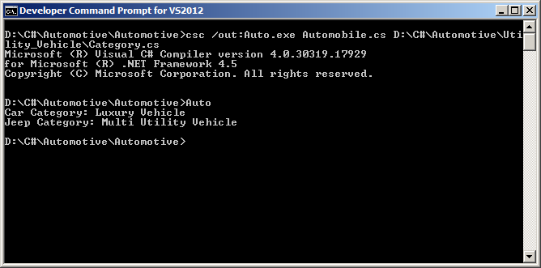
Namespace Alias Qualifier 8-10
class Automobile
{
static void Main(string[] args)
{
Category objCat = new Category();
objCat.Display();
Utility_Vehicle::Category objCategory = new
Utility_Vehicle::Category();
objCategory.Display();
}
}
}
}
Output
In the code:
In the class Automobile, the namespace alias qualifier is used.
The alias Utility_ Vehicle is specified in the left operand and the class Category in the right operand.

Slide 57
Namespace Alias Qualifier 9-10
The alias qualifier is used when a user needs to define the class System in the custom namespace.
C# does not allow users to create a class named System.
If a class named System is created and a constant variable named Console is declared within this class, the compiler will generate an error on using the System.Console class.
This is because C# includes the system defined namespace called System.
This problem can be resolved by using namespace alias qualifier with its left operand defined as global as shown in the following code:
Snippet
using System;
namespace ITCompany
{
class System

Slide 58
Namespace Alias Qualifier 10-10
WriteLine method of my System class
In the code:
The namespace alias qualifier is used in the class System.
The left operand of the namespace alias qualifier is specified as global using the global keyword.
Therefore, the search for the right operand starts at the global namespace.
{
const string Console = "Console";
public static string WriteLine()
{
return "WriteLine method of my System class";
}
static void Main(string[] args)
{
global::System.Console.WriteLine (WriteLine());
}
}
}
Output

Slide 59
Summary
A namespace in C# is used to group classes logically and prevent name clashes between classes with identical names.
The System namespace is imported by default in the .NET Framework.
Custom namespaces enable you to control the scope of a class by deciding the appropriate namespace for the class.
You cannot apply access modifiers such as public, protected, private, or internal to namespaces.
A class outside its namespace can be accessed by specifying its namespace followed by the dot operator and the class name.
C# supports nested namespaces that allows you to define namespaces within a namespace.
External aliasing in C# allows the users to define assembly qualified namespace aliases.

Slide 60

THANKS FOR WATCHING !

